Slide 1
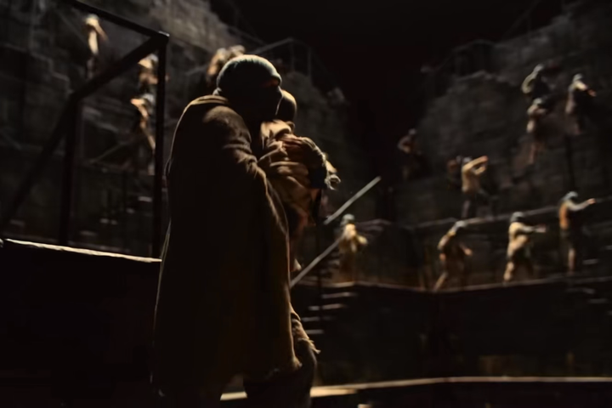
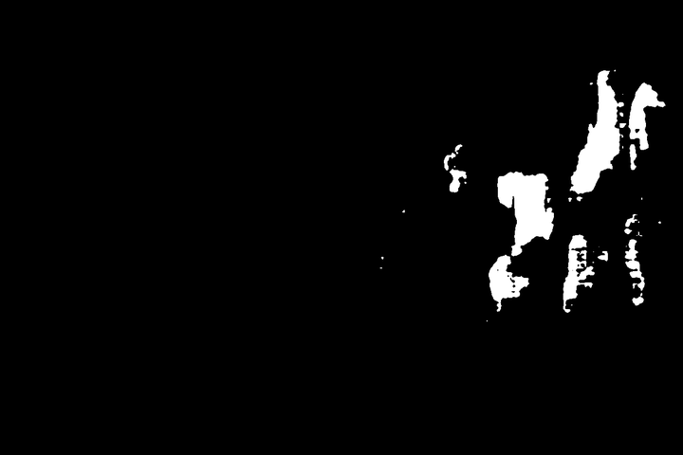
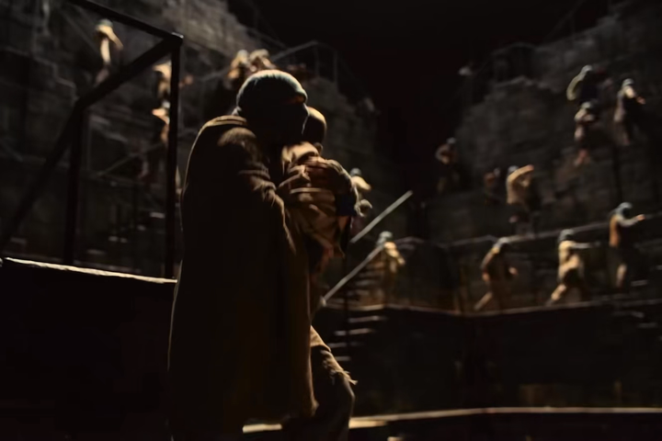
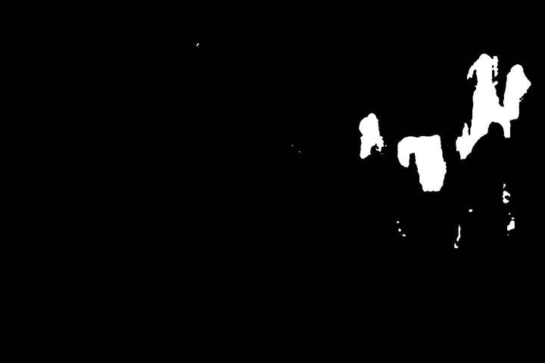
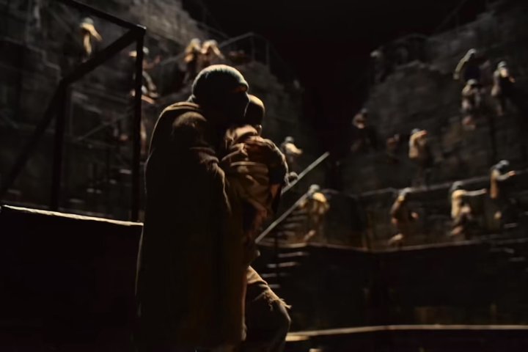
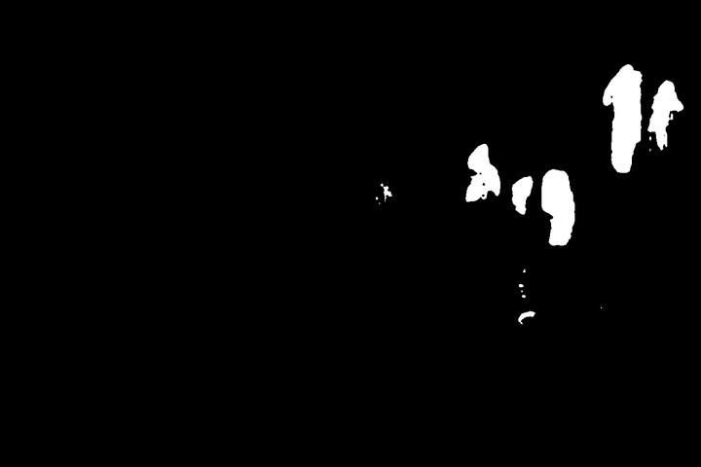
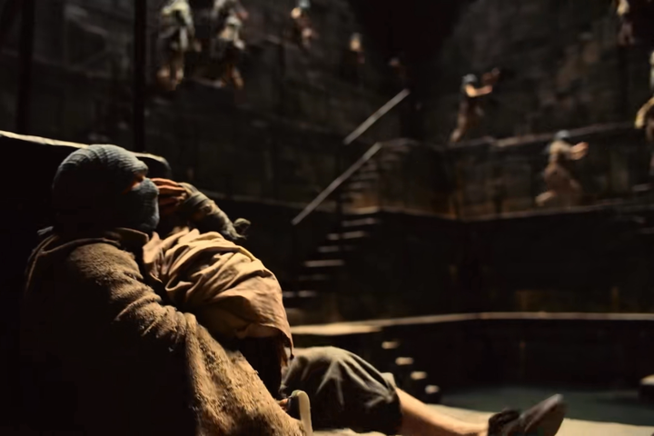
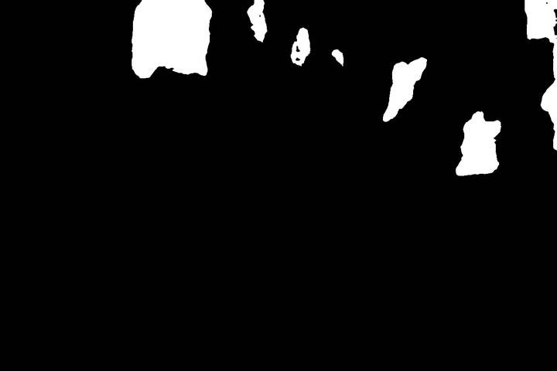
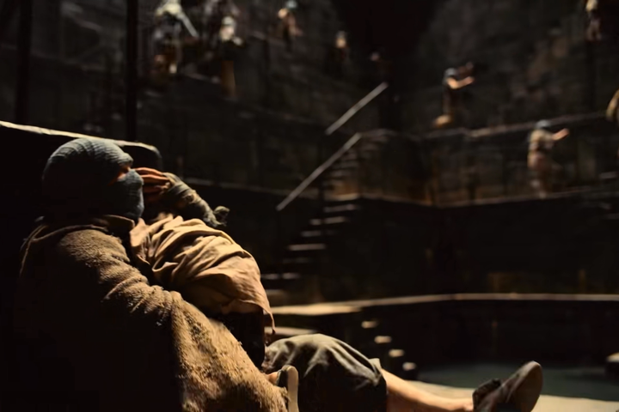
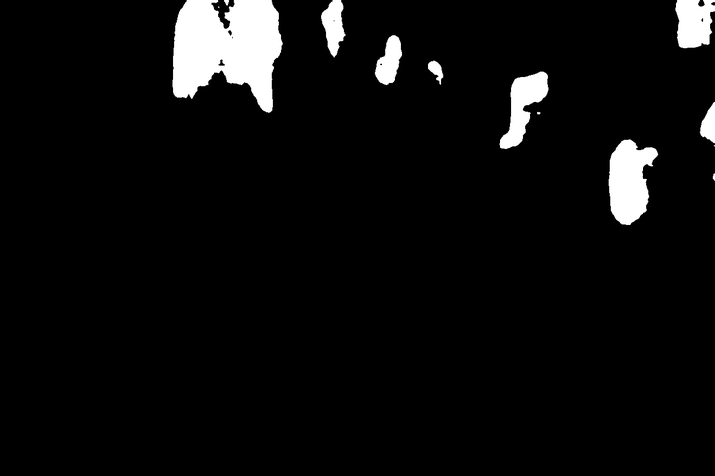

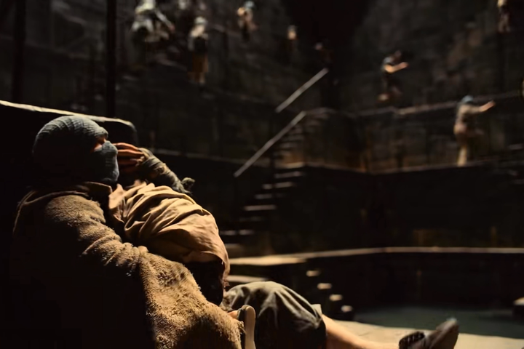

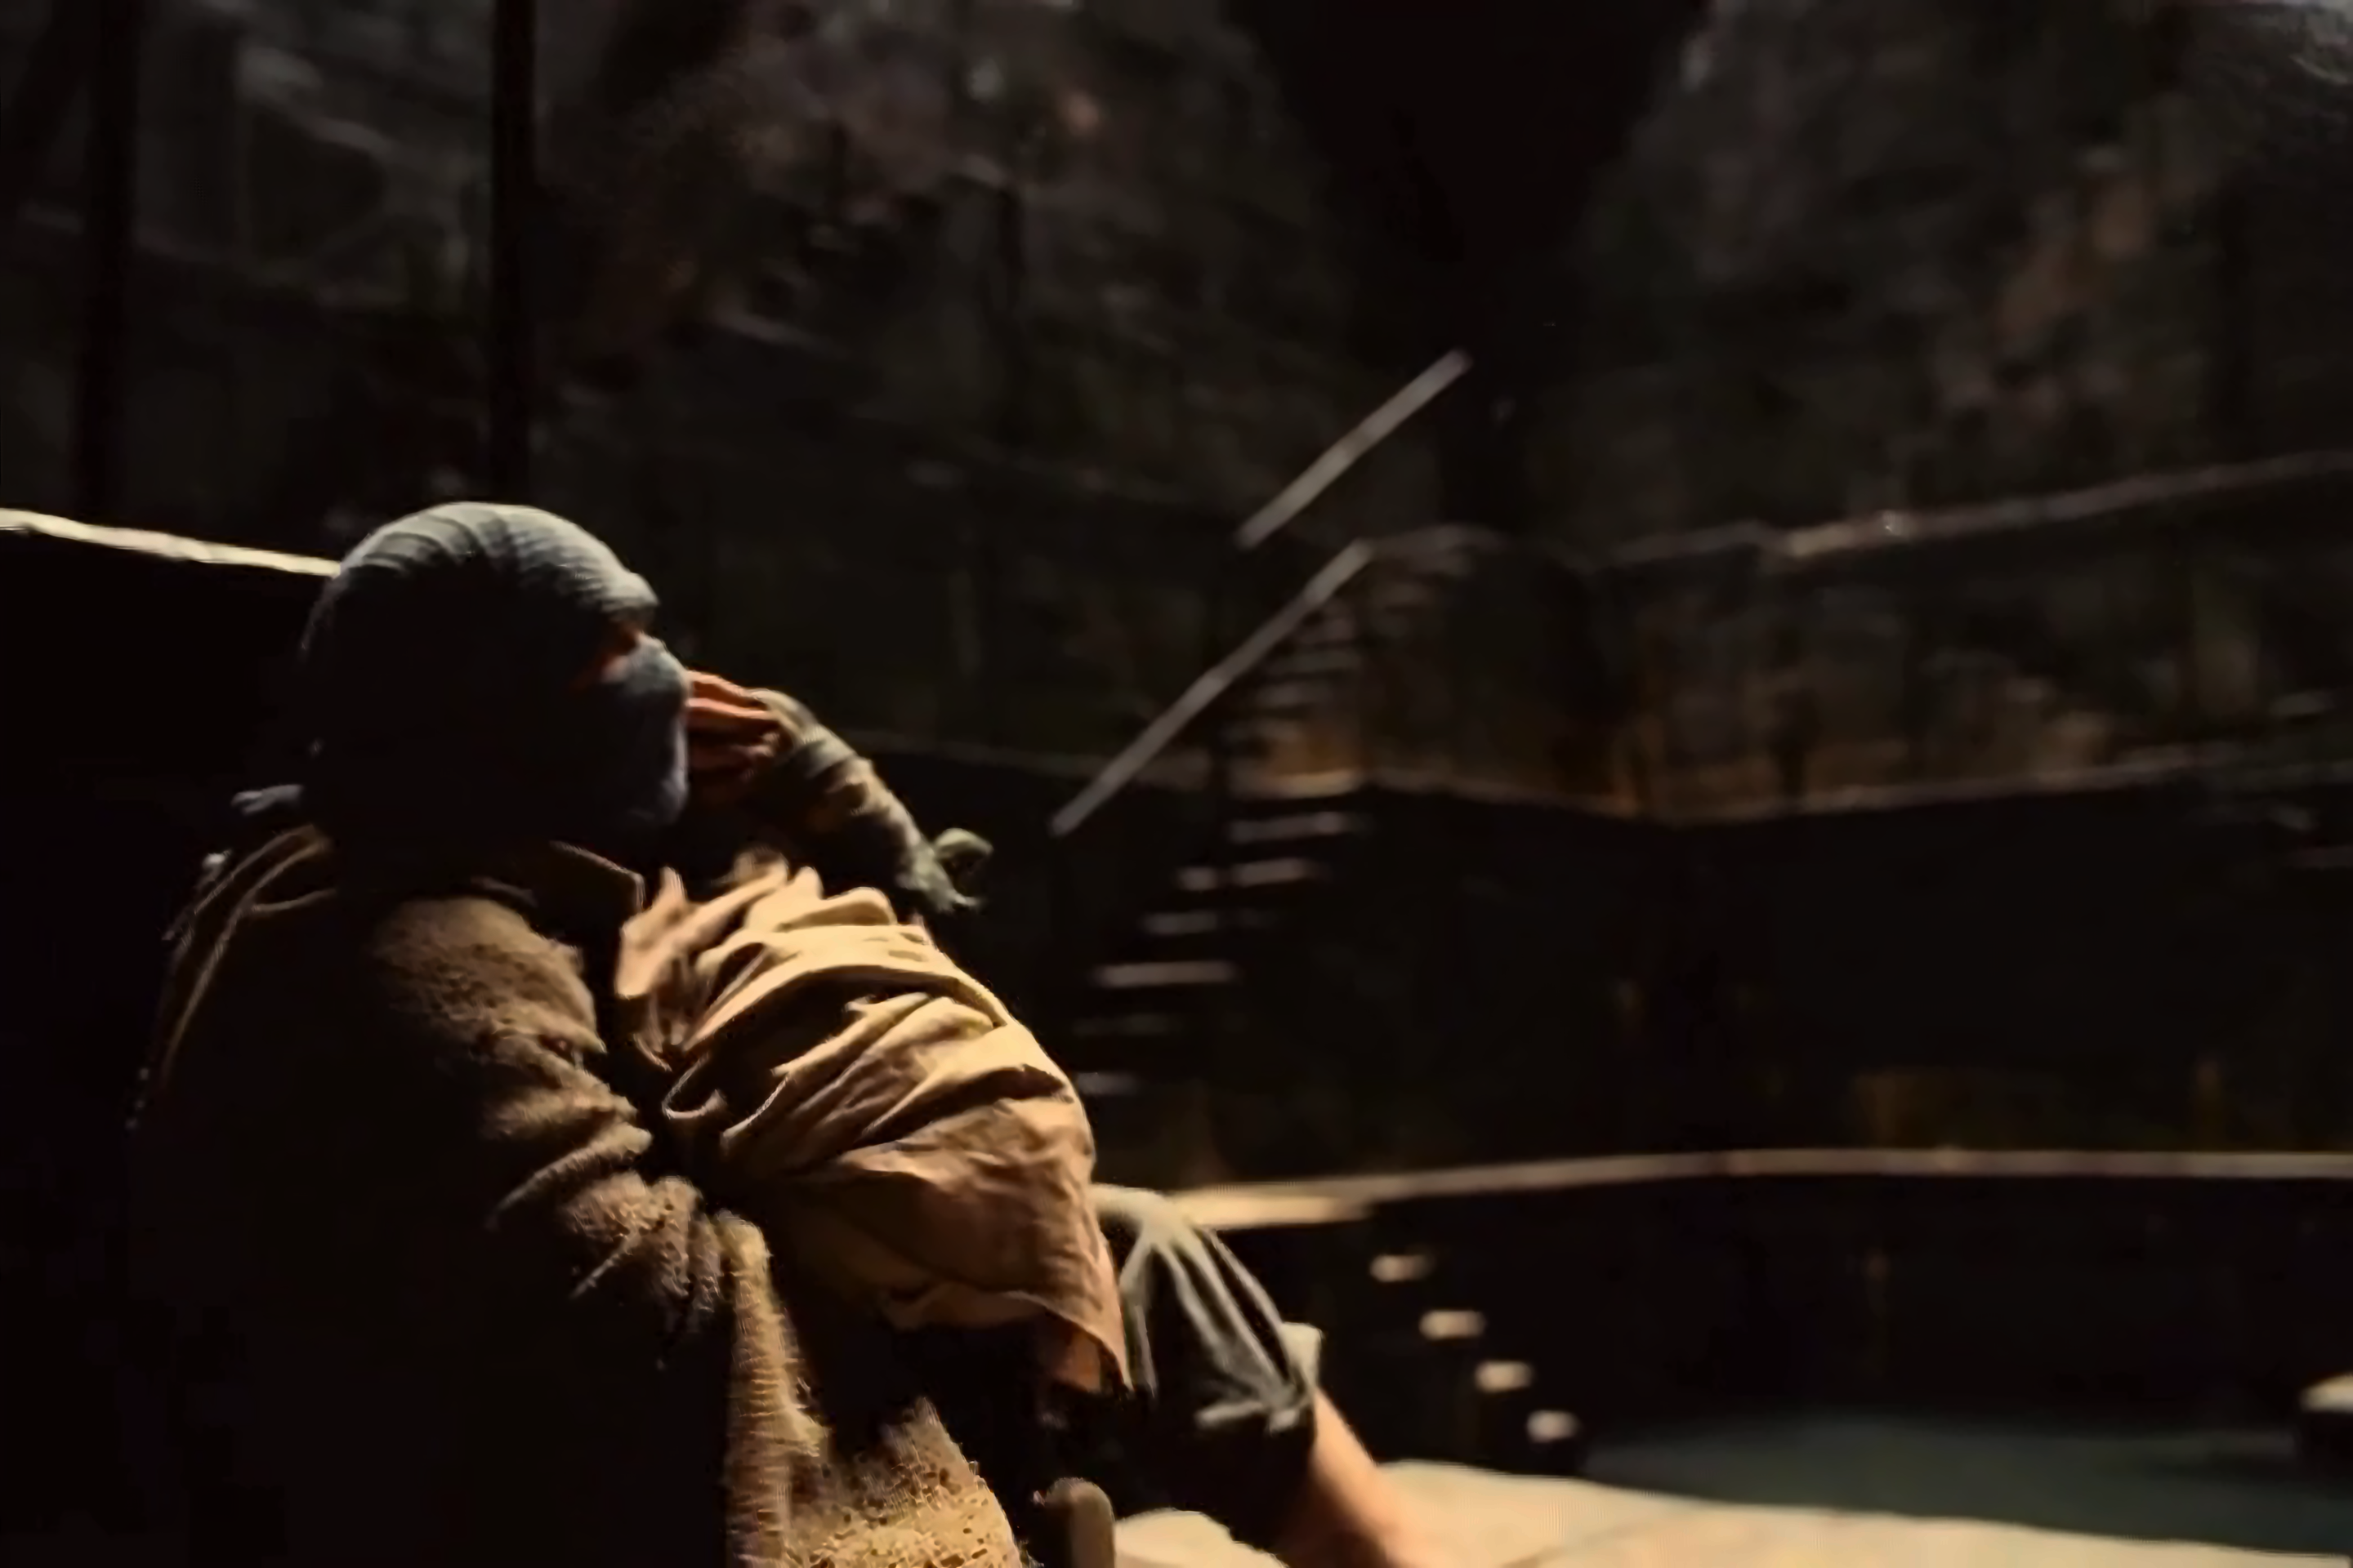
Local Frames Block
n=3
Flow-Based Image Feature Propagation Network
Flow Completion Network Module
Feature Forward
Propagation Module
N
Propagate Local-Frames
Feature Encoding Information
Flow-Based Local Frame Feature
Temporal Focal Transformer Block
Temporal Focal Transformer Block
Temporal Focal Transformer Block
...
P-MASk
Frame Mask Generation
Local Features=3
n=3
Non-Local Frame Feature
Hiera-B Encoder
Non-Local Featuresn=3
Decoder
Non-Local Frames Block
Inpainting Images

Slide 2
Local Frames Block
n=3
Flow-Based Image Feature Propagation Network
Flow Completion Network Module
Feature Forward
Propagation Module
N
Propagate Local-Frames
Feature Encoding Information
Flow-Based Local Frame Feature
Temporal Focal Transformer Block
Temporal Focal Transformer Block
Temporal Focal Transformer Block
...
P-MASk
Frame Mask Generation
Local Features=3
n=3
Non-Local Frame Feature
Hiera-B Encoder
Non-Local Featuresn=3
Decoder
Non-Local Frames Block
Inpainting Images

Slide 3
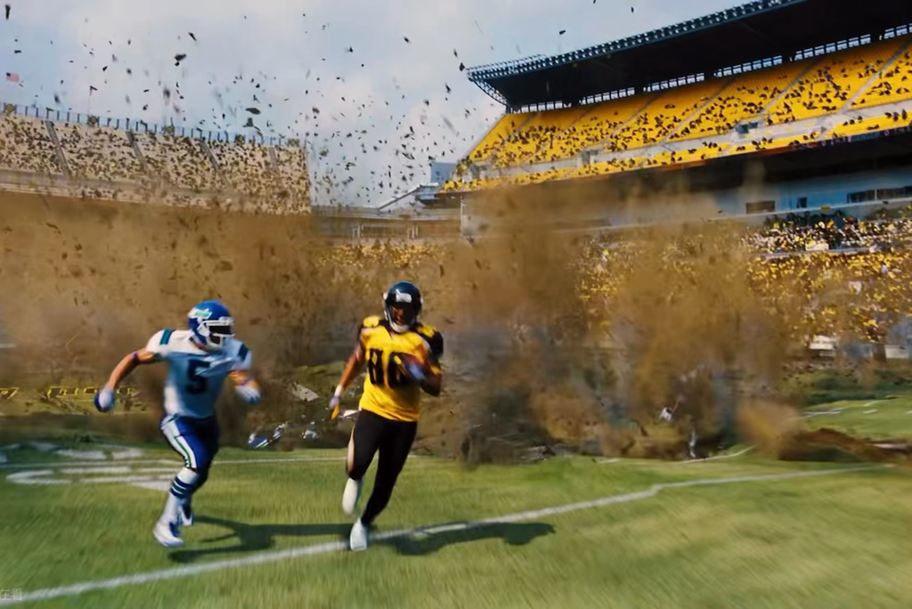
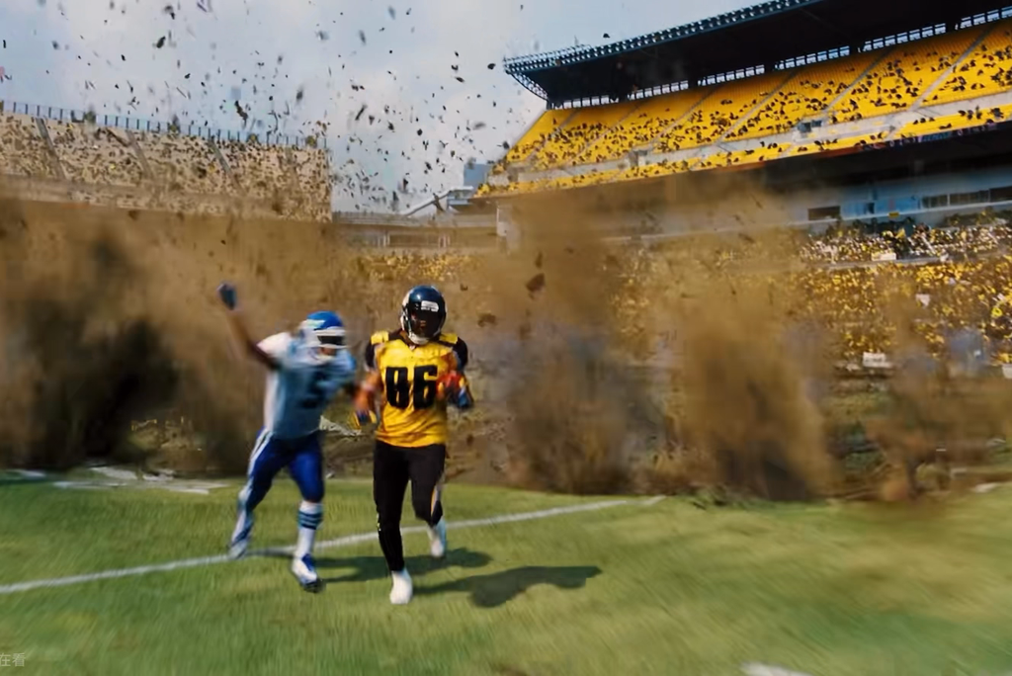
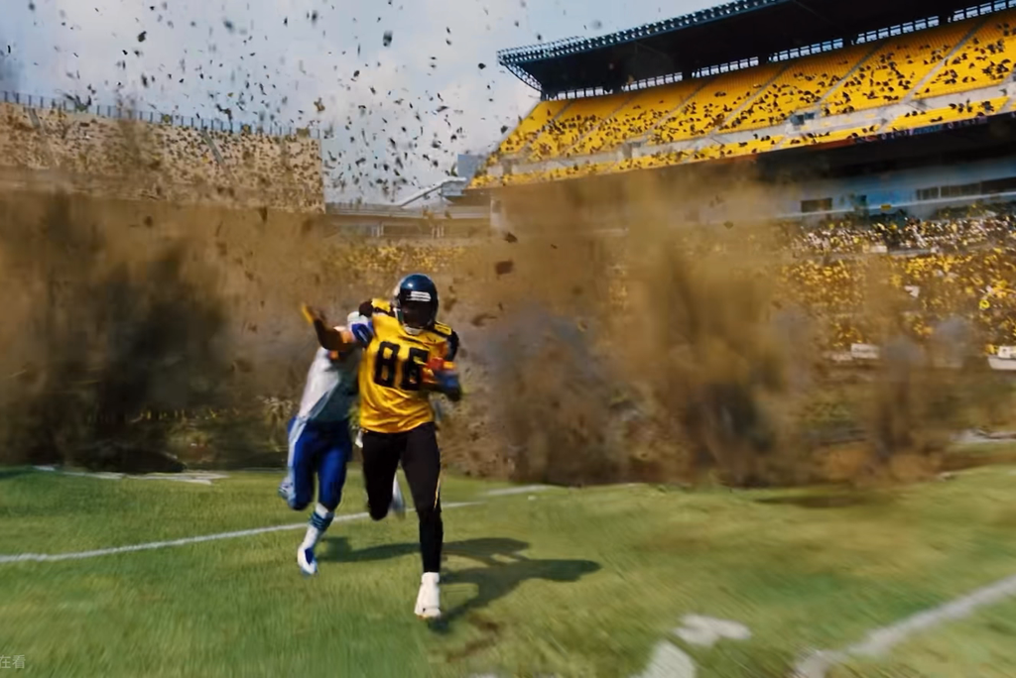
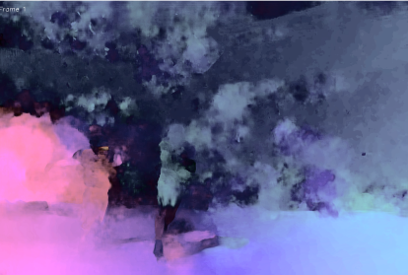
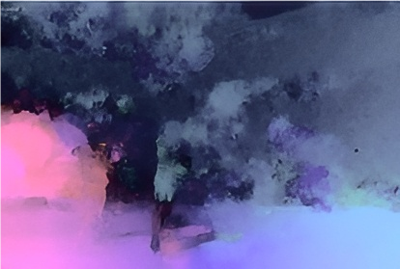
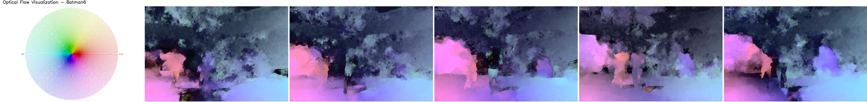
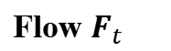
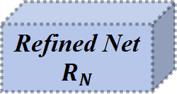
n=3
Concat Data
Concat
FramesWindow
Flow $F_{t}$
n=3
Frame t-1
Frame t
Frame t+1
Conv1
Conv
0
Image Pyramid 1
Image Pyramid 2
Deconv
Initial Flow
Frame t-1
Upsample
Conv2
Conv
Flow1
Frame t
Deconv
Flow1
Warping
Upsample
Refined Image
Conv3
Conv
Flow2
Refined Net
$$R_{N}$$
Frame t+1
Flow2
Deconv
Concat
Data
Upsample
Stacking Optical Flow Map (n=5)
Flow3
(a) Spatial Pyramid Block of Flow Estimation
(b) Spatial Pyramid Network and Refined Block

Slide 4
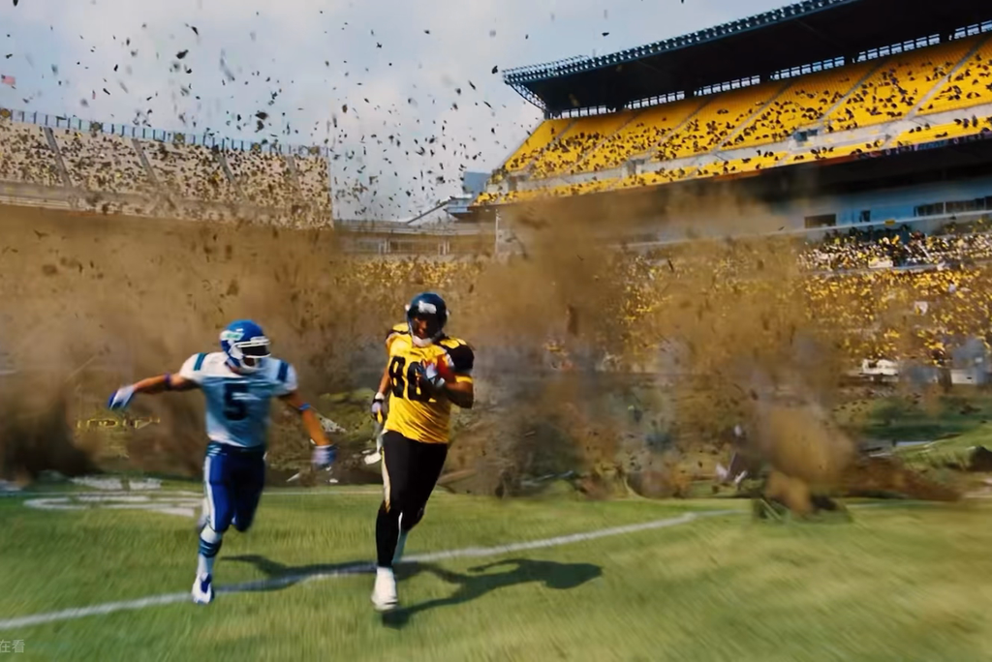
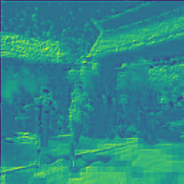
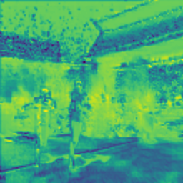
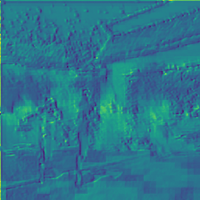
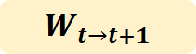
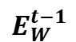
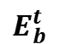
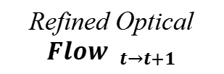
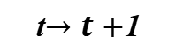
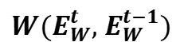
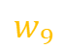
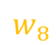
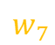
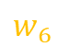
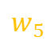
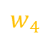
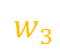
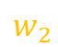
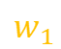
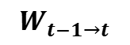
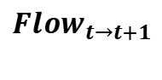
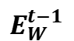
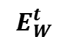
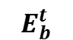
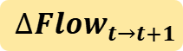
Refined Optical ${Flow }_{t→t+1}$
Pixel-Wise Weight Matrix
Frame t
$$W_{t−1→t}$$
Weighted Historical Visual Features
$$w_{1}$$
$$w_{2}$$
$$w_{3}$$
$$E_{W}^{t−1}$$
$$w_{4}$$
$$w_{5}$$
$$w_{6}$$
$$W(E_{W}^{t}, E_{W}^{t−1})$$
$$w_{7}$$
$$w_{8}$$
$$w_{9}$$
Hiera-B
Visional Encoder
Warping Encoder Net
$$E_{b}^{t}$$
Basic Visual Feature Propogation
Basic Features
Concatenation
$$E_{b}^{t}$$
$$E_{W}^{t−1}$$
Basic Encoder
Visional Feature
Flow-Based
Visional Feature
$${Flow}_{t→t+1}$$
Conv
LReLU
Refined Flow
...
Conv
LReLU
$$W_{t→t+1}$$
t$→t+$1
Lightweight Convolution
Weight Mask
$${∆Flow}_{t→t+1}$$
DCN
Deformable
Convolution
Optical Flow Displacement
Flow-Based
Visional Feature
Conv
LReLU
Concatenation
$$E_{W}^{t}$$
...
Conv
LReLU
(a) Lightweight Convolution Network
Prepare the Prediction for DCN Input
(b) Feature Forward Propagation Optical-Flow Based Module:
the opposite direction for Backward Flow Propagation

Slide 5
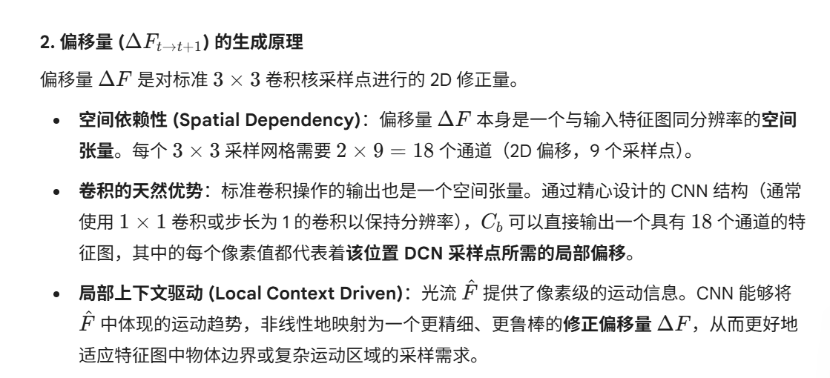
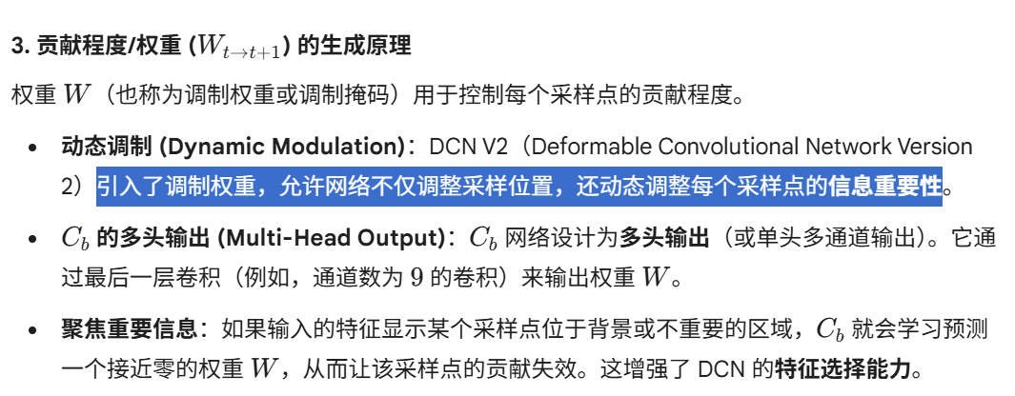
CNN 是强大的空间特征映射器：它能将多源（特征、对齐信息、运动）的输入特征图，映射为一个具有特定通道数（用于编码 $3K$ 个偏移量和权重参数）的空间参数图。

Slide 6
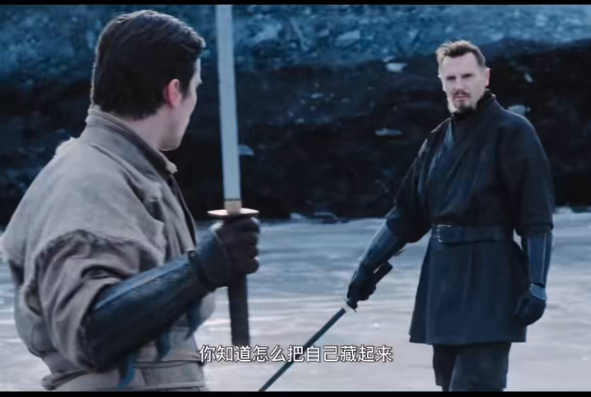
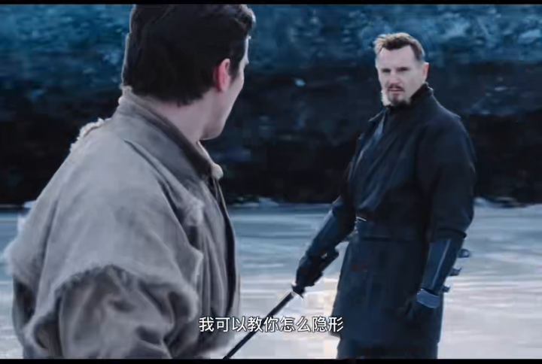
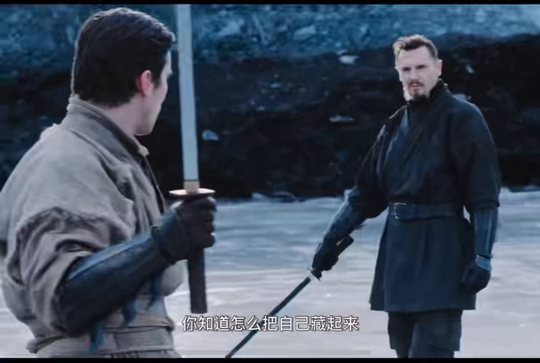





































$$f_{t}$$
$$f_{t+K_{1}N}$$
$$f_{t+1}$$
$$f_{t+K_{1}N+1}$$
$$f_{t+2}$$
$$f_{t+K_{1}N+2}$$
$$×3$$
$$×3$$
$$f_{t}$$
N=3
N=3
$$f_{t+1}$$
$$f_{t+2}$$
Flatten
...
$$W_{q}$$
Local Frame Block
Non-Local Frame Block 1
$$f_{t+K_{2}N}$$
$$f_{t+K_{3}N}$$
$$f_{t+K_{2}N+1}$$
$$f_{t+K_{3}N+1}$$
Local Frame Block
$$f_{t+K_{2}N+2}$$
$$f_{t+K_{3}N+2}$$
$$×12$$
$$×3$$
$$×3$$
Multi-Head
Self-Attention
N=3
N=3
Non-Local Frame Block 2
Non-Local Frame Block 3
Sub-Window ($\frac{1}{2}$) Pooling
Stacking (1 Local + 3 Non-Local)
3-local
$$Sample f_{t}$$
$$Sample f_{t+K_{i}N}$$
$${Sample f}_{t+1}$$
$${Sample f}_{t+K_{i}N+1}$$
$${Sample f}_{t+2}$$
$${Sample f}_{t+K_{i}N+2}$$
$$W_{k} W_{k}$$
9-Non
...
$$×3$$
Sample Local Frames
Sample Non-Local Frames
Coarse-Grained Block
1-local & 3-Non-local
$$×12$$

